Slide 1
A New Nation
The thirteen States create a firm union under the Constitution

Slide 2
Government post Revolution
Each state had a constitution- a written plan of government
3 branches of government
Legislature
Governor
Courts
Articles of Confederation are adopted
States realized that a regular government was needed for the nation
States were joined in a union known as the Confederation

Slide 3
Powers Granted to Government under the Articles of Confederation
Declare war and make peace
Make treaties with foreign countries
Establish an army and navy
Appoint high-ranking military officials
Requisition, print, and borrow money
Establish weights and measures
Hear disputes among the states related to trade or boundaries

Slide 4
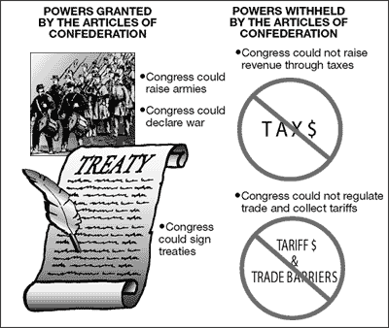

Slide 5
Powers Denied to Government
No power to raise funds for an army or navy
No power to tax, impose tariffs, or collect duties
No executive branch to enforce laws
No power to control trade among the states
No power to force states to honor obligations
No power to regulate the value of currency

Slide 6
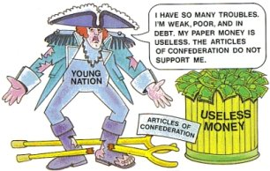
Problems Facing the New Nation
No President with power to carry out laws
No supreme courts to settle important disputes
Trade with foreign nations
Financing the nation
Foreign relations
Interstate relations

Slide 7
Problems with Trade
U.S. no longer the favorite trading partner of Great Britain
U.S. exports to British ports had to be on British ships
Many U.S.-produced goods were barred from British ports
Britain sent vast amounts of cheap goods to U.S.
Potential Remedy
Establish a tariff on British goods
Weakness in Articles of Confederation preventing this solution

Slide 8
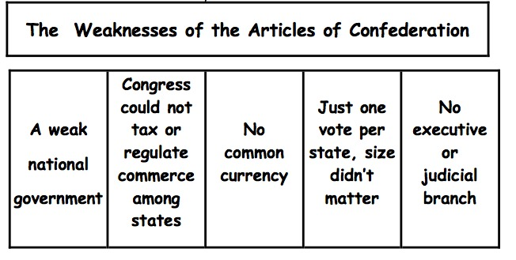

Slide 9
Do Now: how can the new nation expand?

Slide 10
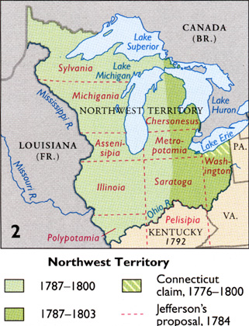
Ordinances- laws
Northwest territory: the land north of the Ohio River and east of the Mississippi
Land Ordinance of 1785: a system of surveying and settling the Northwest Territory
Land was divided into townships
Townships= 36 sections
Section= 1 square mile
Congress planned to sell sections to settlers $640

Slide 11
Northwest Ordinance (1787)
Government for Northwest territory
Guaranteed basic rights to settlers
Outlawed slaves
Once a territory had 60,000 settlers→ asked Congress to be admitted as a new state
Provided a new way to gain new states and expand the nation
New states were treated the same as original 13
New states: Ohio, Indiana, Illinois, Michigan, & Wisconsin

Slide 12
Shay’s Rebellion
The American Revolution left the new states in an economic depression
The farmers were very successful during the Revolution because there was a high demand for farm products
Post-Revolution farmers weren’t able to pay back their loans
The courts seized farms
1786: Daniel Shay, Massachusetts farmer, organized an uprising
2,000 famers participated
Attacked courthouses
Prevented the state from seizing farms
Tried to capture an arsenal filled with guns
Massachusetts legislature sent the militia to stop them
A sign that the Articles of Confederation were weak
Leaders from several states called for a convention to revise the Articles of Confederation
Philadelphia in May, 1787
Constitutional Convention

Slide 13
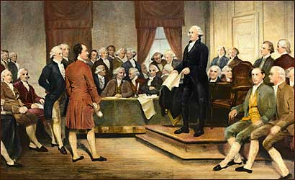
The writers of the Constitution
George Washington- immediately elected chairman
Well respected
Commander of the
army that won independence
Benjamin Franklin
Oldest and wisest
Writer, publisher, and inventor
James Madison (Virginia)
Knew a lot about government
Took careful notes at the convention

Slide 14
The Virginia Plan The New Jersey Plan
Congress makes laws, president enforces laws, courts protect justice
3 branches:
Legislative Branch
Executive Branch
Judicial Branch
2 houses:
Seats in each house based on population
Small states were against the Virginia Plan
Feared they wouldn’t have any power
Weaker central government
3 branches of government
Legislature = 1 house
One vote per state

Slide 15
Do Now: What are the states going to argue about and have to compromise on in the Constitution?

Slide 16
Questions
Which Plan will state with large populations prefer?
How would it make them more powerful?
Which Plan will smaller states like?
Why would the smaller states have a problem with that plan?

Slide 17
Compromises
The Great Compromise:
Congress would be bicameral (2 houses)
House of Representatives- states would be represented by population
Senate- the states would be equal
2 senators from each state
Three-Fifths compromise
Southerners wanted slaves to be counted as people to have more representation
Northerners said if slaves can’t vote they shouldn’t be counted
Compromise: 5 slaves= 3 people
Slave laws
Northern sates wanted to ban slave trade within their borders
Wanted to ban slavery in the entire nation
It would crush the southern economy
Results: -Congress could not outlaw salve trade for at least 20 years
No state could stop a fugitive slave from being returned to an owner

Slide 18
School house rock: http://www.bing.com/videos/search?q=singing+the+constitution&view=detail&mid=45EF65C33462FD7DACCC45EF65C33462FD7DACCC&first=0&FORM=NVPFVR
Signing the Constitution:
38/42 delegates from the convention signed the constitution
9/13 states endorsed the Constitution

Slide 19
Bill of Rights

Slide 20
Do Now: Did you have any interactions with the constitution during your vacation?

Slide 21
Federalists Vs. Anti-federalists

Slide 23
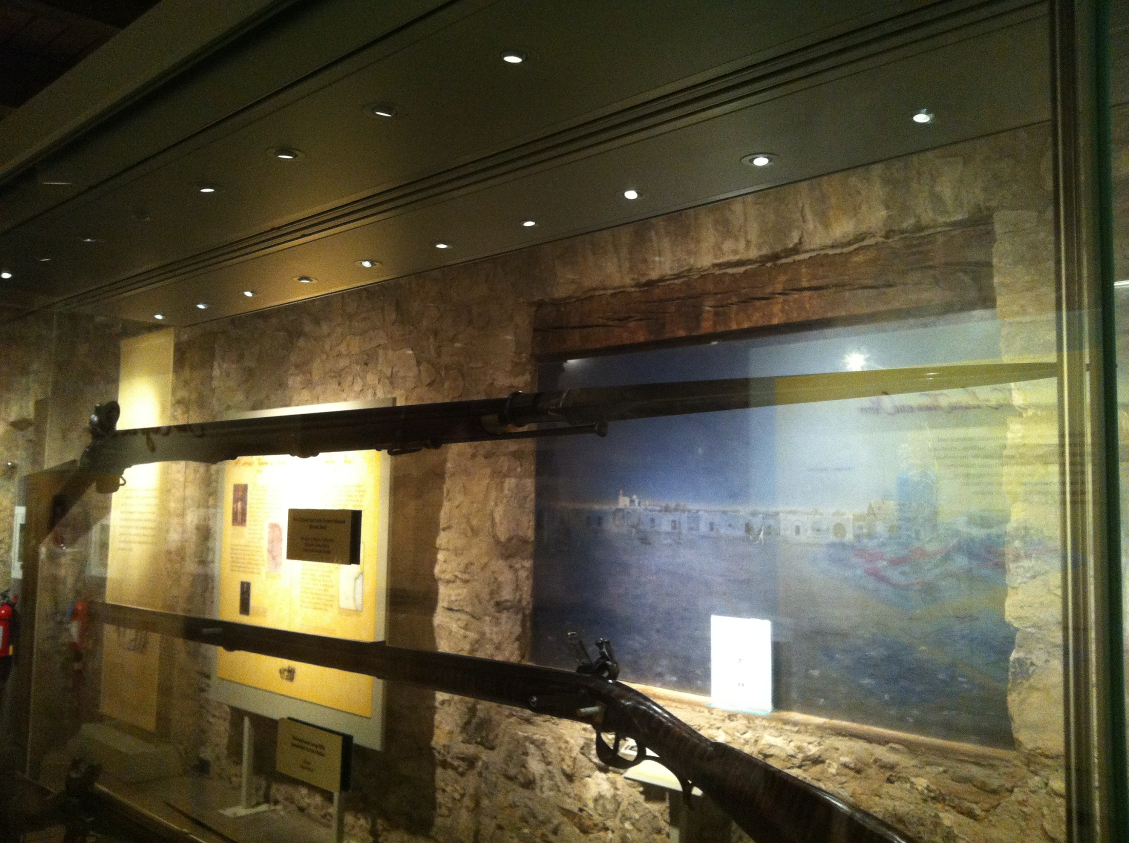

Slide 24
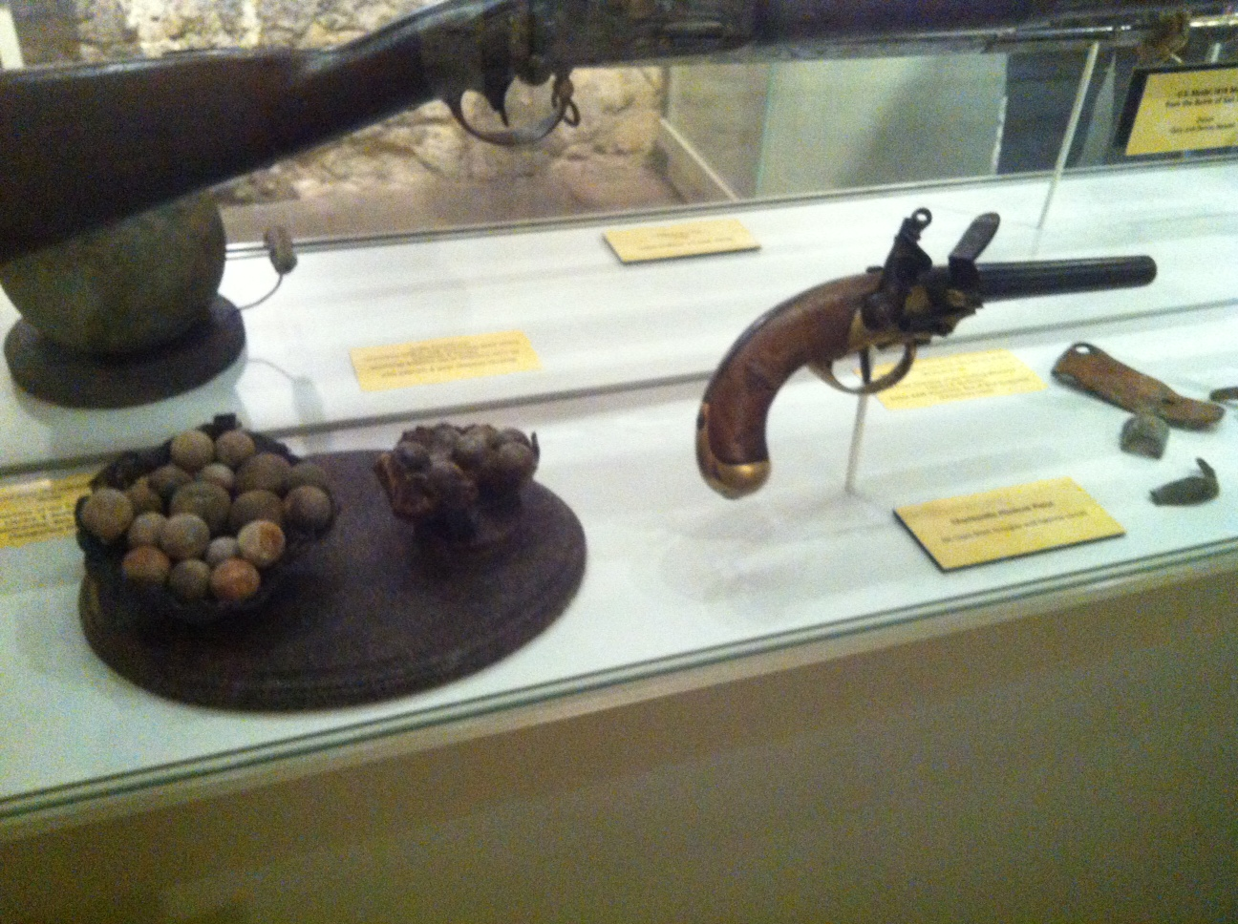

Slide 25
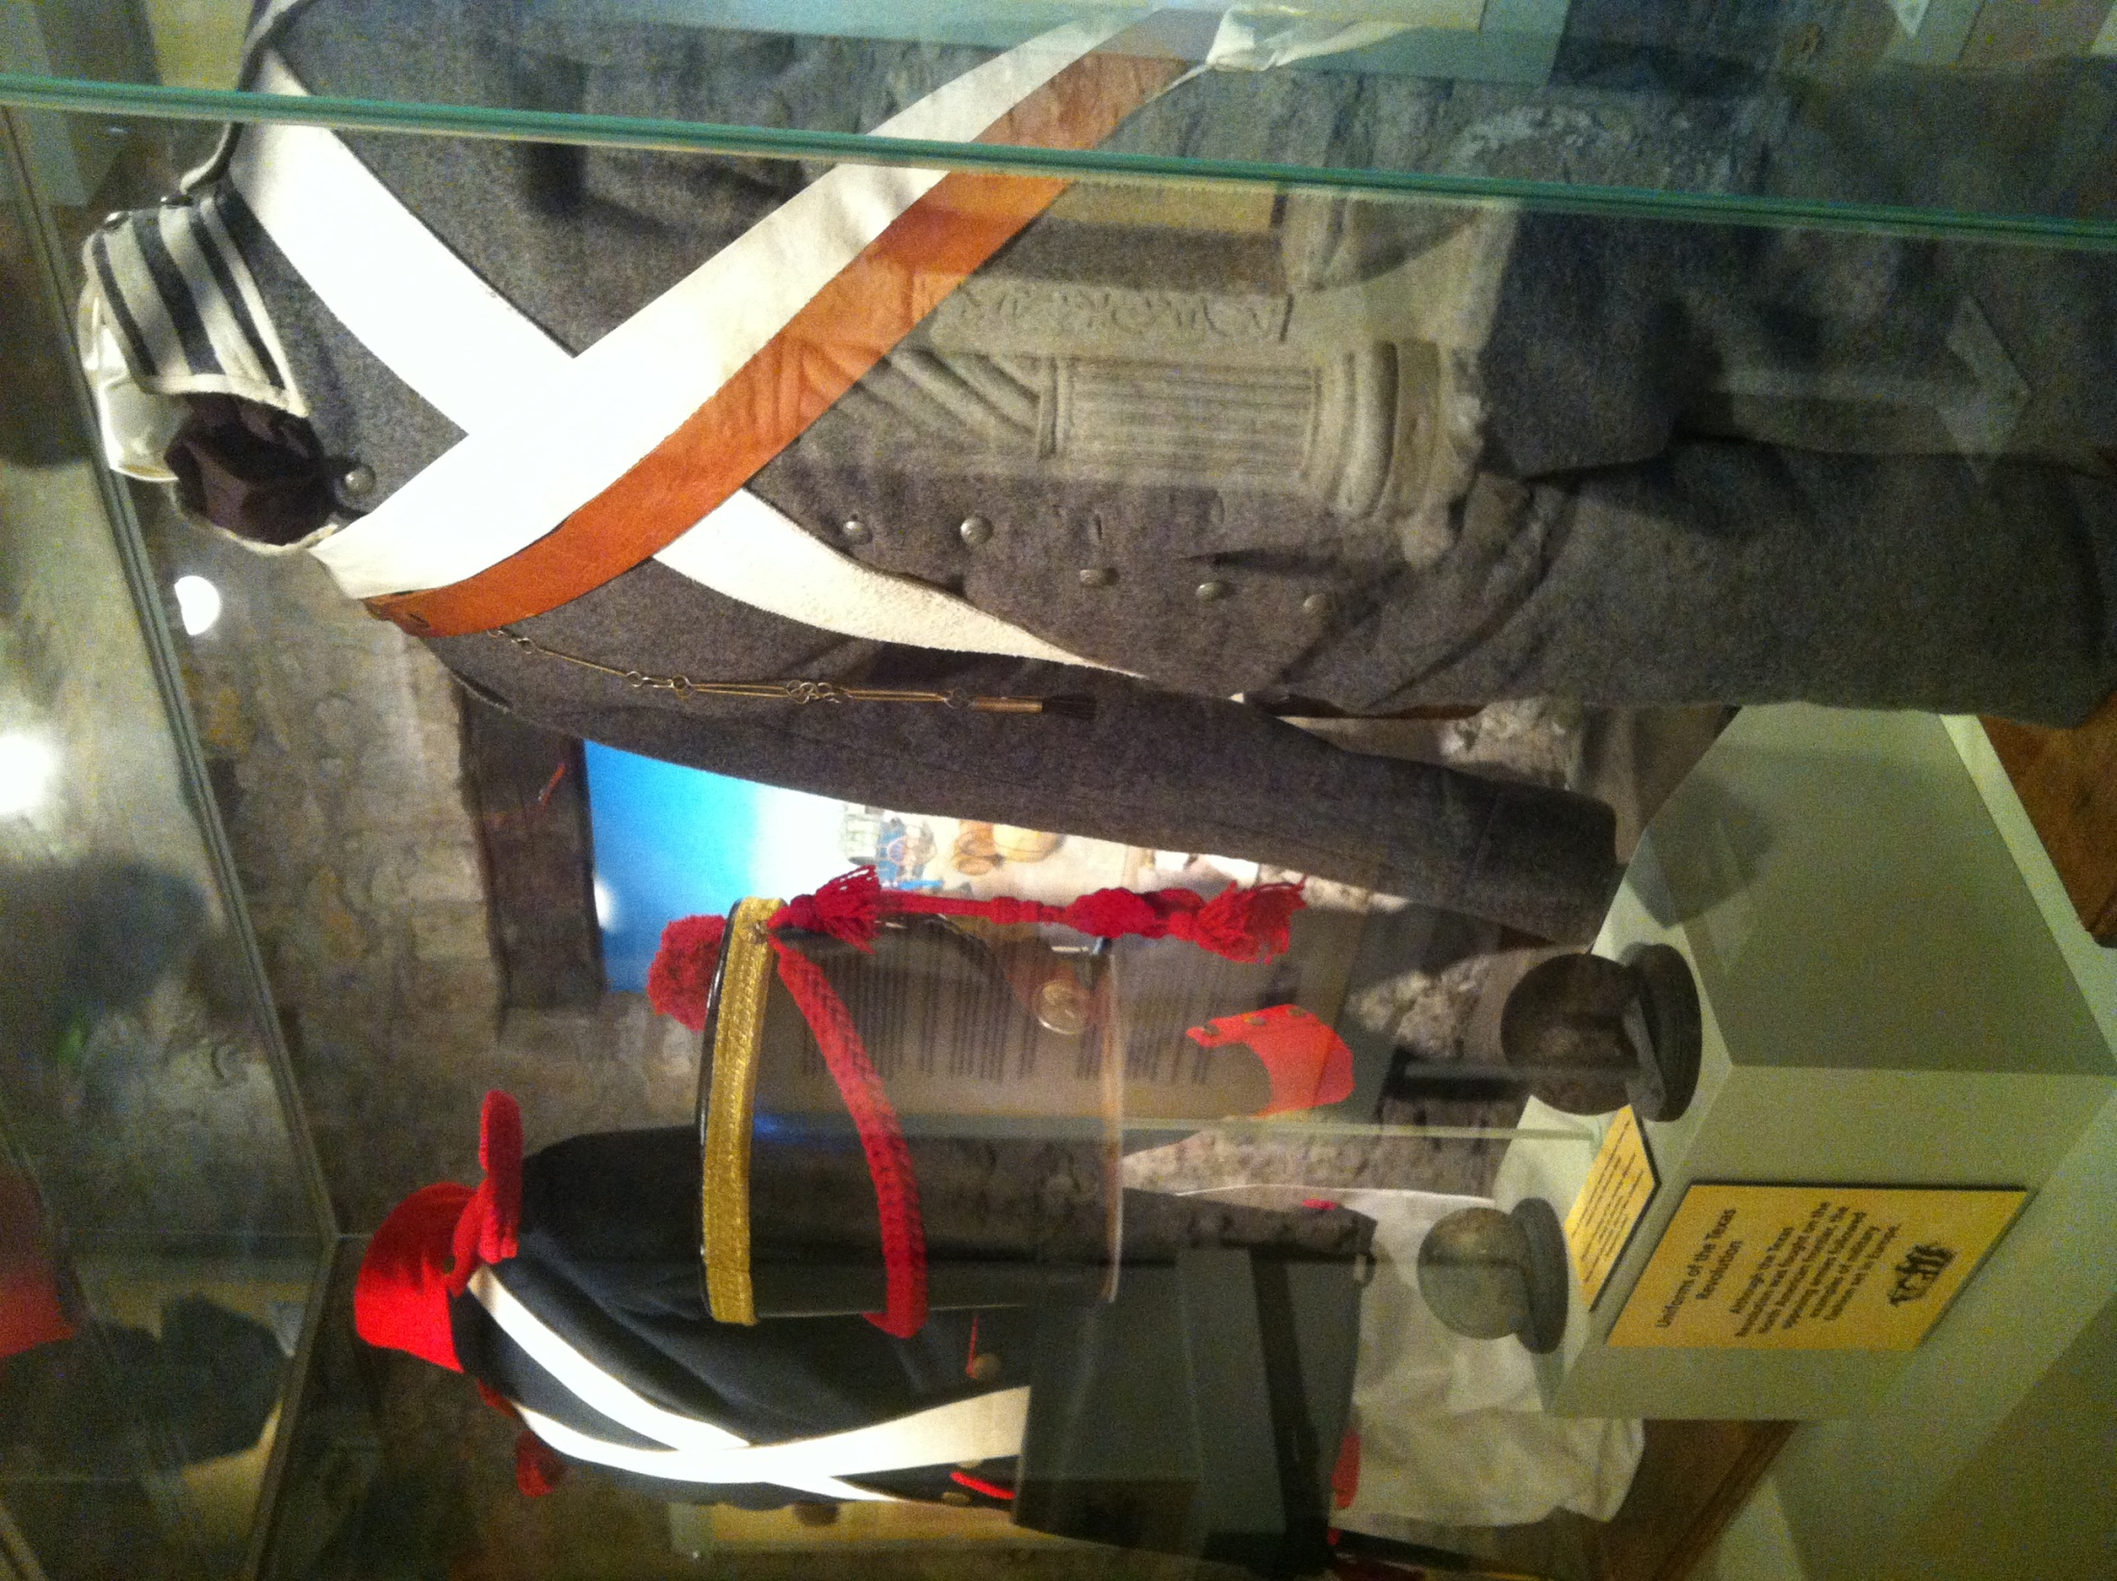

Slide 26
Preamble of the Constitution
Opening statement- American people announce the Constitution and its goals.
Form a More Perfect Union
To get the states to work together as part of a single united nation
Establish Justice
Establish fairness- laws applied fairly to every American
Establish courts
Ensure Domestic Tranquility
To keep peace at home
Promote for the Common Defense
To establish the armed forces
Promote for the General Welfare
To protect the well-being of the people
To establish programs that would benefit the people
Secure the Blessings of Liberty
Limit the powers of the government
Bill of Rights
Right to vote
Can remove leaders from office who abuse power

Slide 27
Five Principles of the Constitution
Popular Sovereignty
Limited Government
Federalism
Separation of Powers
Checks and Balances

