Slide 1
Civil War
Ms. Orville

Slide 2
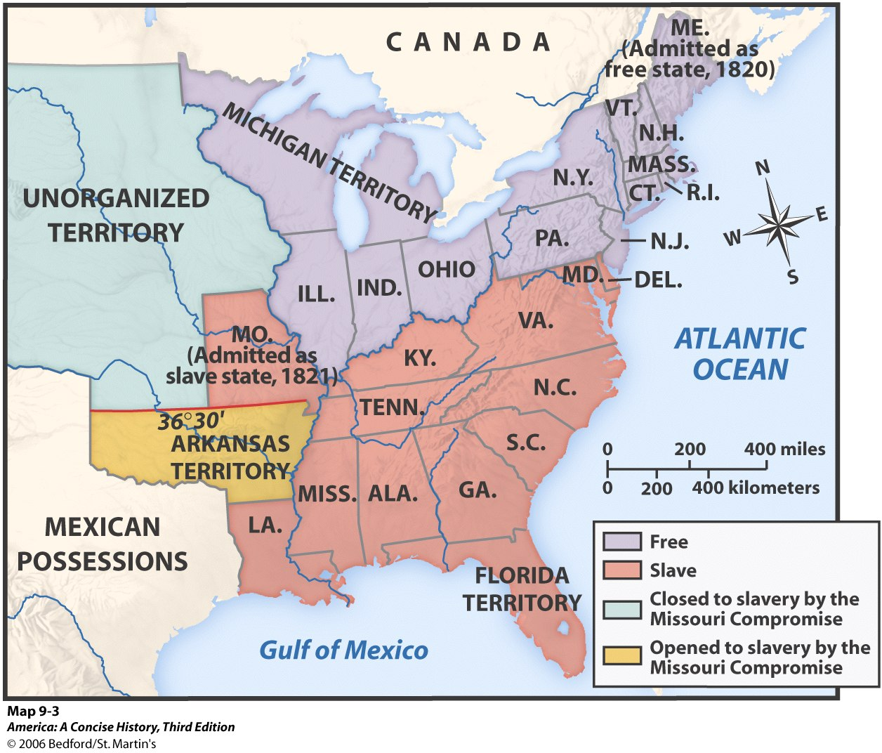
Compromises
Missouri:
Admittance of new states into the country (statehood)
Missouri asked to join the Union as a slave state
Issue of Slavery
Would upset balance in senate
http://www.bing.com/videos/search?q=Missouri+Compromise+in+a+Nutshell&view=detail&mid=679F2524A646DA703B50679F2524A646DA703B50&first=0&FORM=NVPFVR
11 free states/ 11 slave states
Majority would become slave
South would gain majority
Senator Henry Clay
Compromise: admit Maine as a free state
30° 36’
Imaginary line dividing North & South

Slide 4
Compromise of 1850
Compromise:
Allowed California to enter as a free state
Divided the rest of Mexican secession
New Mexico & Utah: voters could decide issue of slavery
Popular sovereignty
Ended the slave trade in Washington DC (capitol)
Strict fugitive slave law
Border dispute between Texas & New Mexico
President: Millard Fillmore
Supported Clay’s compromise
Issue: Admittance of California
15 free states
15 slaves states

Slide 5
Fugitive Slave Law of 1850
Slave law- required all citizens to help catch runaway slaves
People who let fugitive slaves escape could be fined $1,000 and jailed for 6 months
Special courts set up
Judges received $10 for sending “accused” runaway slave to South
$5 for setting someone free
Fugitive: escaped slave; often lived in Northern cities as free citizens

Slide 6
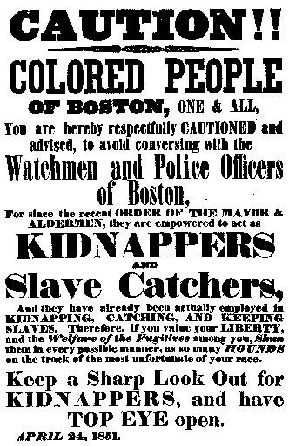
Slave Codes
Forbidden to leave owner’s land
Forbidden to gather in groups of more then 3
Not allowed to own guns
Not allowed to learn how to read or write

Slide 7
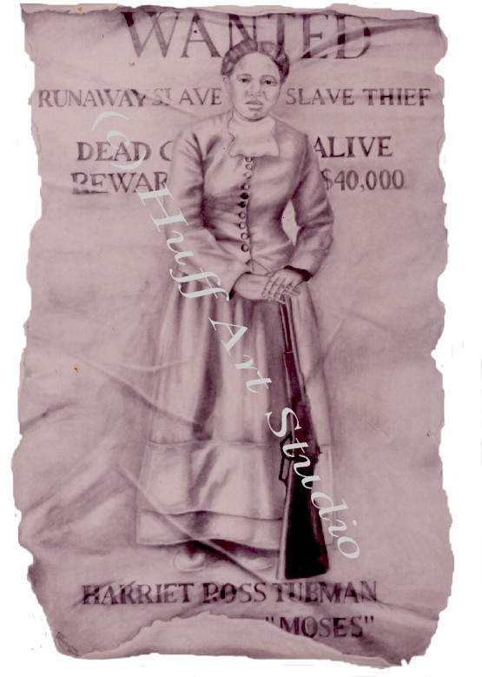
Underground Railroad
A network of abolitionists who secretly helped slaves reach freedom in the North or Canada
NOT A REAL RAILROAD
Harriet Tubman- an escaped slave
The “Black Moses”
Returned to the South 19 times
Brought more then 300 slaves to freedom

Slide 8
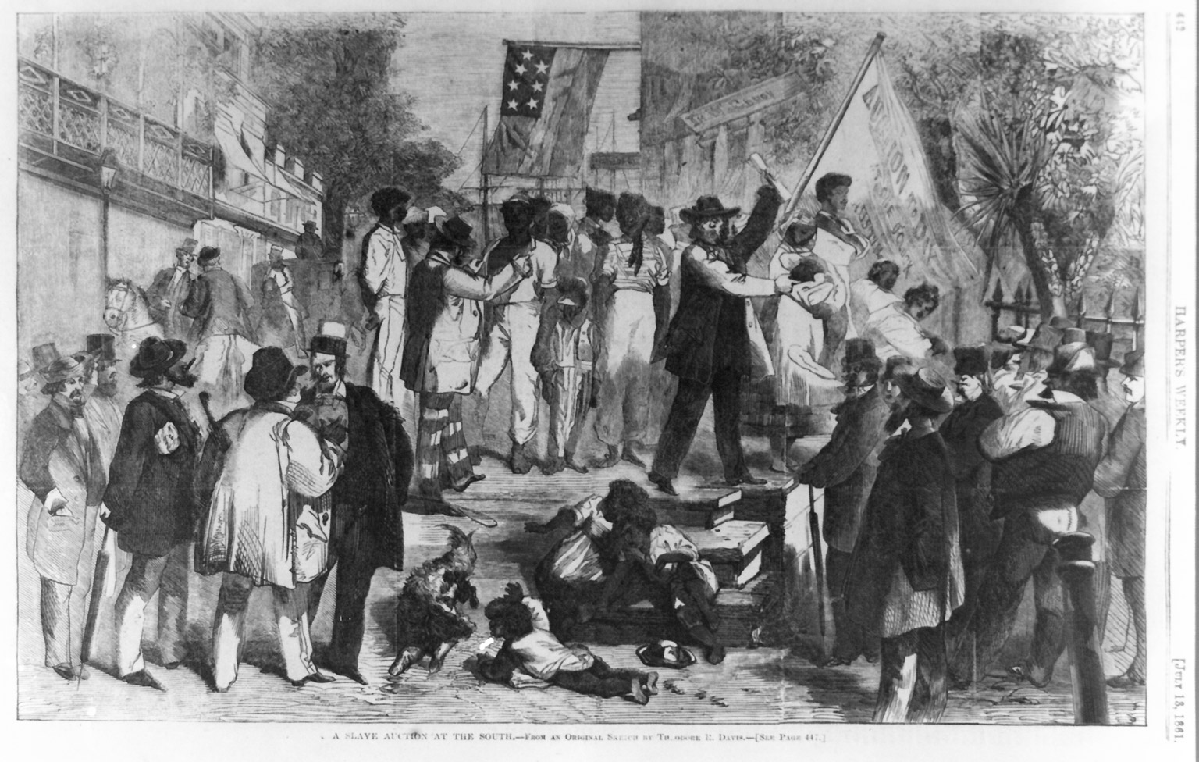

Slide 9
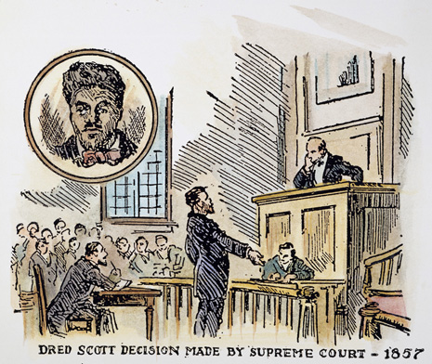
Dred Scott Case (1857)
Supreme court case
Dred Scott: a slave from Missouri
Moved with his owner → Illinois → Wisconsin (slavery not allowed)
Thinking: free territory = free man
Dred Scott decision: slavery was legal in all territories

Slide 10
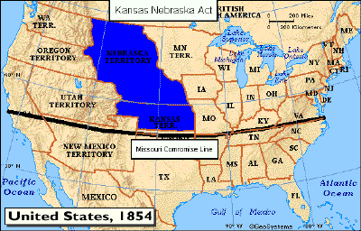
Kansas-Nebraska Act (1854)
Popular sovereignty for Kansas & Nebraska
Proposed by Senator Stephen Douglas
President= Franklin Pierce
Democrat elected 1852
Problem: Missouri Compromise banned slavery in Kansas & Nebraska
Outcome: slavery could now spread into states that had been free for 30 years

Slide 11
Born: backcountry of Kentucky
→ Indiana → Illinois
Only went to school for one year
Career: store owner -> Law -> 8 years in state legislature -> one term in congress
-> decided to run for Senate in 1858 because he greatly opposed the Kansas-Nebraska Act

Slide 12
Lincoln & Slavery
Didn’t believe in “perfect equality”
Believed slavery was “moral, social, & politically wrong”
Blacks were entitled to rights named in the Declaration of Independence “life, liberty, pursuit of happiness”
Totally opposed to slavery in territories
NOT an abolitionist
Didn’t want to interfere with already slave states
Knew nation couldn’t survive if divided about slavery
June 16, 1858:
“A house divided against itself cannot stand”

Slide 13
Do Now: Was John Brown a madman or a martyr?

Slide 14
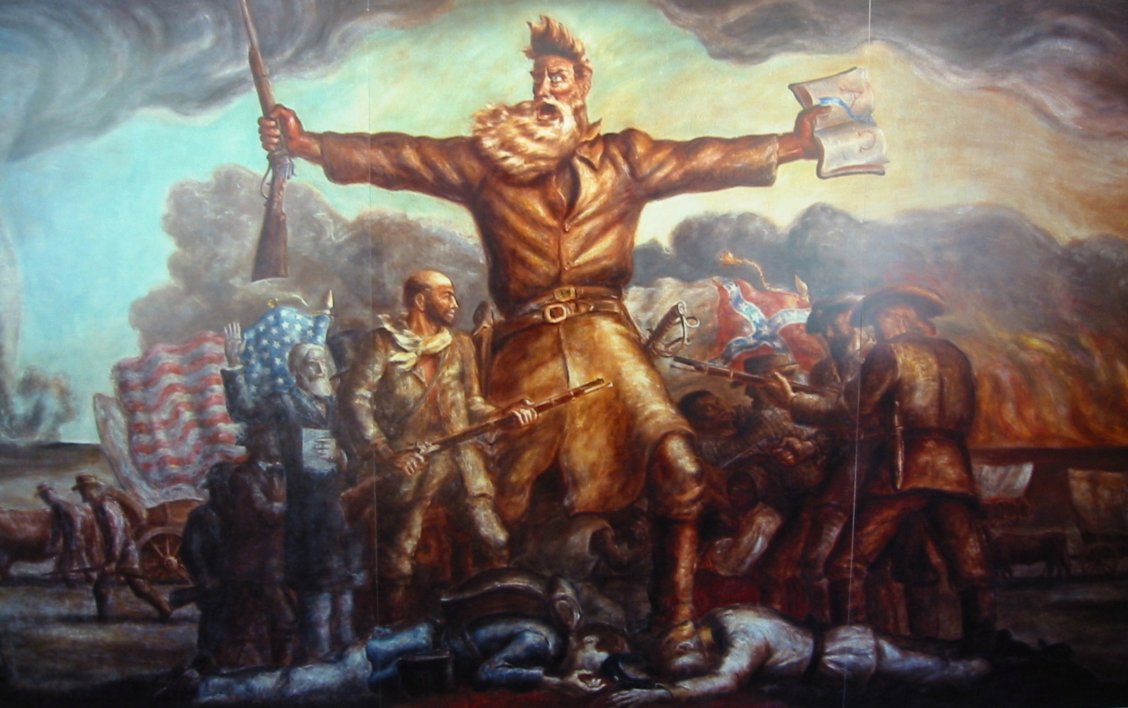

Slide 15
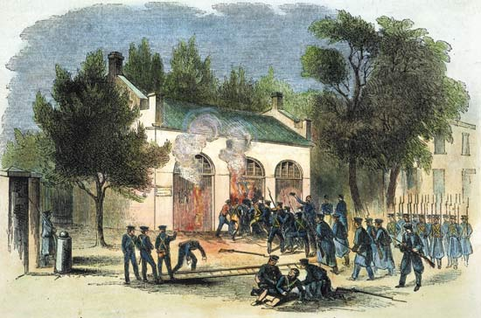
John Brown’s Raid
1859: Harper’s Ferry, VA
John Brown planned a raid an arsenal and start a slave riot
Failure
He became a martyr in the North
South thought north wanted to destroy slavery & the south

Slide 16
Election of 1860
May 1869: Republican National Convention
Abraham Lincoln got the Republican nomination
Election:
Northerners outnumbered Southerners
Lincoln WON
10 southern states didn’t even have Lincoln’s name on the ballot
Southerners felt they no longer had a voice in national government

Slide 17
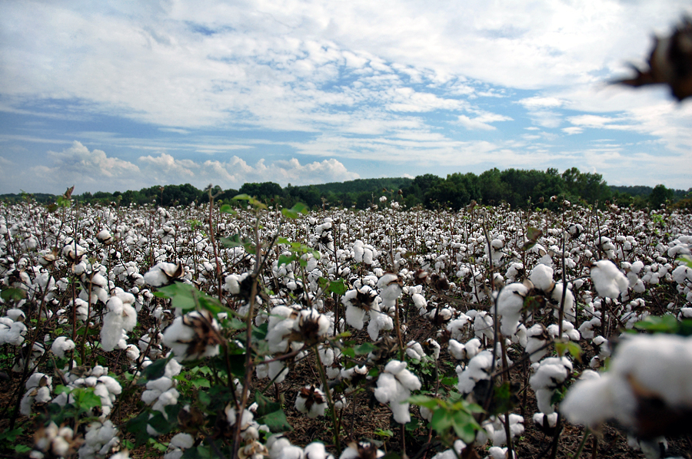

Slide 18
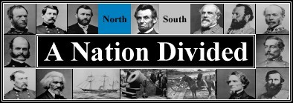
1861-1865
North = Union
South = Confederate

Slide 19
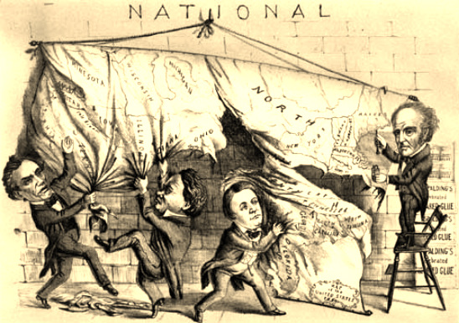
Border states
Lincoln did NOT want the border states to secede
1. Martial Law
Lincoln proclaimed martial law in Maryland
All civil courts were shut down
The U.S. army ruled the state
2. suspended Habeas Corpus
People could be arrested with out a trial

Slide 20
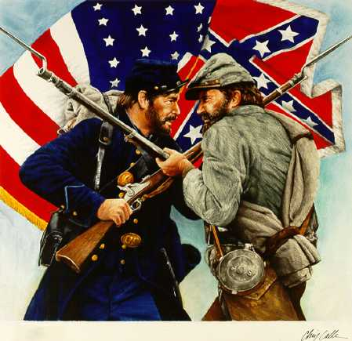
Secession & the Confederacy
South Carolina seceded from the Union December 1860
Feb 1861: Alabama, Florida, Georgia, Louisiana, Mississippi, & Texas secede
Jefferson Davis as President
Confederate constitution recognizes slavery

Slide 21
Union vs Confederacy

Slide 22
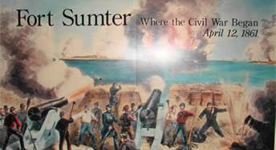
Lincoln urges southern states to reconsider
Vows to hold federal forts in South
Confederates attack and capture Fort Sumter in harbor of Charleston, South Carolina
Lincoln called for 75,000 militia to suppress rebellion and to blockade rebel ports in South
4 more states secede
Arkansas, North Carolina, Tennessee, & Virginia

Slide 23
Strengths
NORTH
Much richer- better able to finance a war
Much more industrialized
Manufacture weapons & other important supplies
Three times the population of the south
Control of U.S. Navy
Advanced railroads
SOUTH
Large area made conquest difficult
Southern soldiers familiar with the area
More passionate
Larger number of qualified senior officers
Robert E. Lee

Slide 24
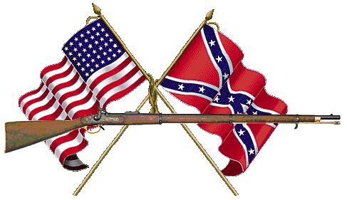
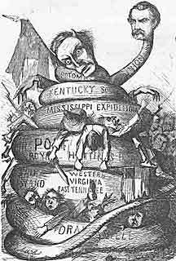
North’s plan
Anaconda Plan
Cut the south into pieces
Capture the Mississippi River to cut the South in two
** most important action of the Civil War strategy
Naval Blockade of the southern ports
Not very effective
75% of rebel ships snuck through the blockade
Southern Plan
Fight a defensive war until the North got tired

Slide 25
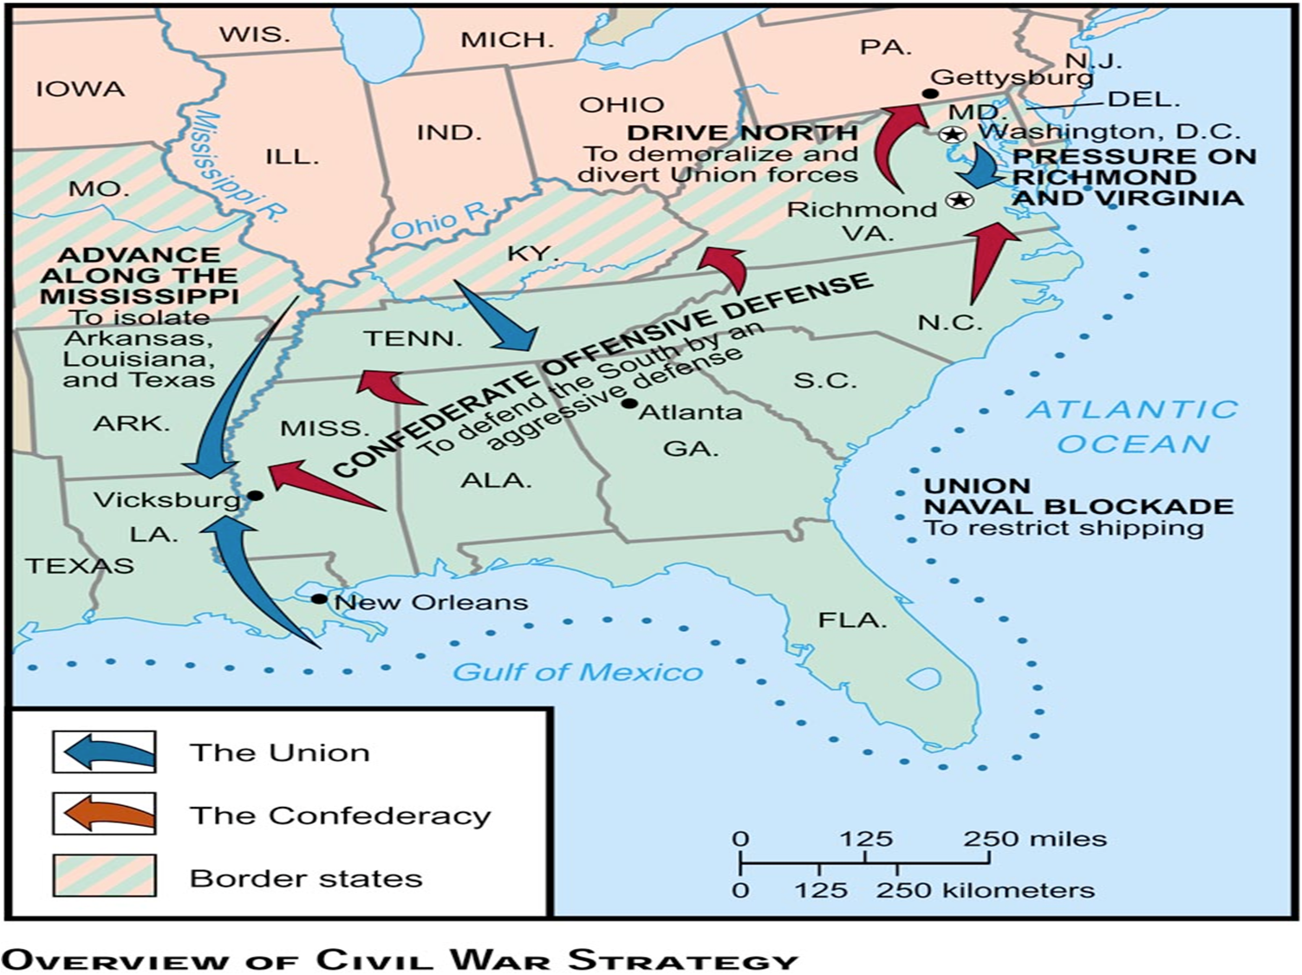
Civil War strategy

Slide 26
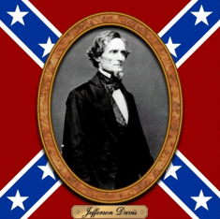
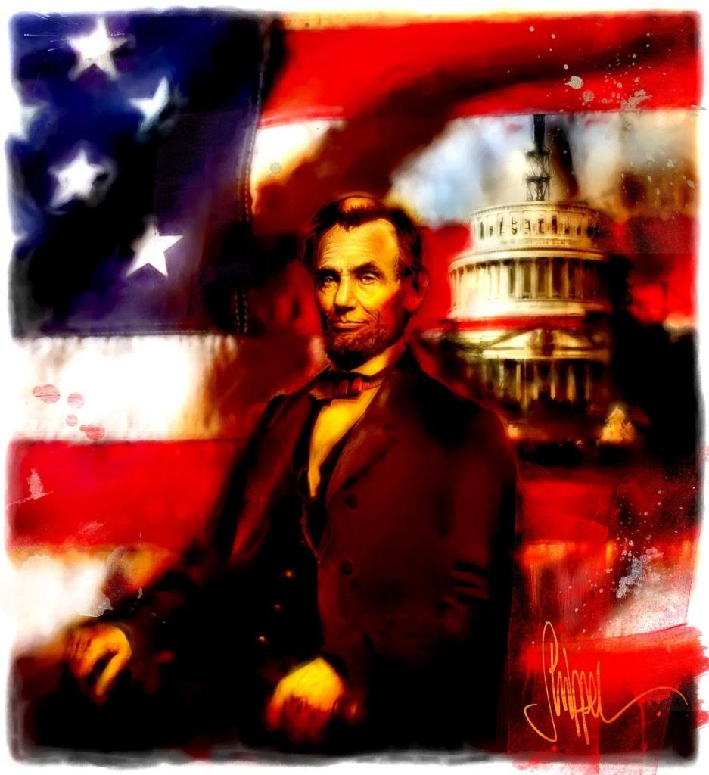
Wartime leaders
The South
Jefferson Davis: President
Robert E. Lee: Commander of the Confederate Army
Stonewall Jackson
The North
Abraham Lincoln- President of the United States
General George McClellan- Commander of the Union army of the east
General Ulysses S. Grant- Commander of the Union army of the west (eventually entire union army)
General Sherman

Slide 27
First Battle: The Battle of Bull Run
July 1861
North expected a quick and easy victory
General Thomas Jackson bravely held the position- earned him the name “Stonewall”
Forced the union Army back to Washington, D.C.
Shows war will be long and difficult to win
Showed both sides that their soldiers needed training
http://www.bing.com/videos/search?q=battle+of+bullrun&view=detail&mid=852A9BFFCF83A8513318852A9BFFCF83A8513318&first=0&FORM=NVPFVR

Slide 28
Reenactment
http://www.bing.com/videos/search?q=battle+of+bullrun&view=detail&mid=4B0C13A4D39F513E4F5B4B0C13A4D39F513E4F5B&first=0&FORM=NVPFVR

Slide 29
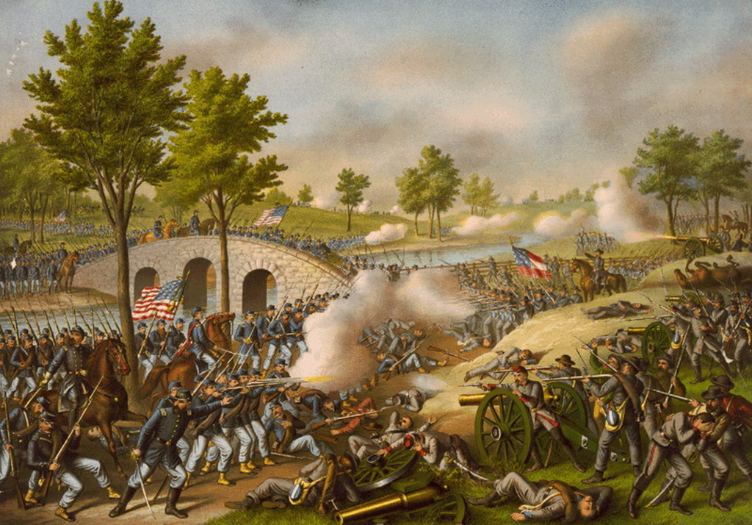
Antietam
September 17, 1862
Bloodiest day of American history
23,000 soldiers were killed, wounded or missing after twelve hours
Draw
(no clear
winner)

Slide 30
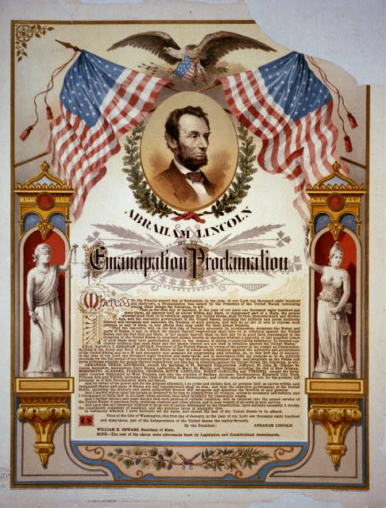
Emancipation Proclamation
Lincoln believed he could only save the union by broadening the goals of the war
Decided to emancipate the enslaved African Americans living in the Confederacy
At the start of the Civil war 3 million slaves worked in the Confederacy
Greatly helped the war effort

Slide 31
Goals of the emancipation
Freed those slaves located in Southern states that had seceded
But not in the border states
Made the destruction of slavery a Northern war aim
Allowed for the enlistment of African Americans in the union
Discouraged any interference by foreign governments

Slide 32
Emancipation…
Draft law
1863
Required all able-bodied males between 20-45 to serve in the military if called
Could avoid the draft by paying the government $300 or hiring someone to serve in his place
North needed the draft law
Needed more men to fight the war
Because of Emancipation proclamation African Americans could now serve in the army
African Americans weren’t actually “freed” until the 13th Amendment to the Constitution

Slide 33
54th Massachusetts Regiment
All black unit of the Union Army
Charged Ft. Wagner in Charleston, North Carolina
St. William H. Carney was the 1st African American to receive the Congressional Medal of Honor
http://www.bing.com/videos/search?q=glory+&view=detail&mid=BC719B063821E1A61516BC719B063821E1A61516&first=0&FORM=NVPFVR
http://www.bing.com/videos/search?q=54th+massachusetts+regiment&view=detail&mid=F742F37440C9BB66AC7AF742F37440C9BB66AC7A&first=0&FORM=NVPFVR

Slide 34
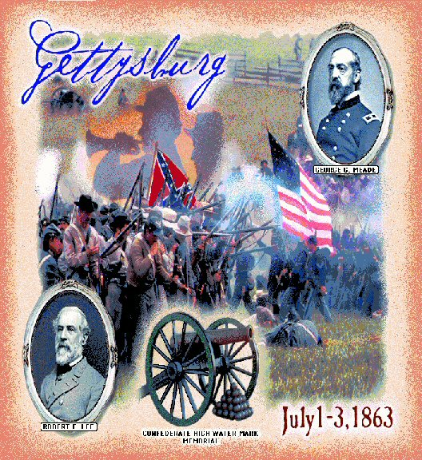

Slide 35
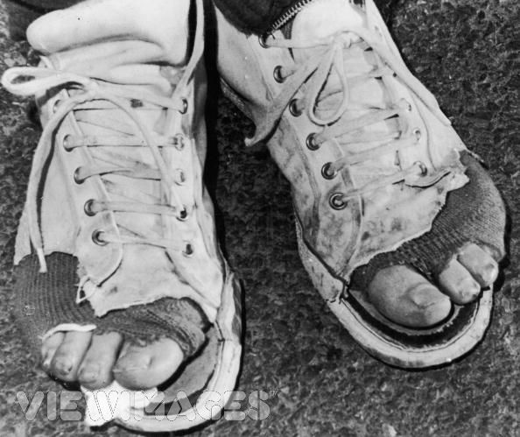
Importance of Gettysburg
Gettysburg in north of Washington D.C.
If south won, they could invade D.C.
Gettysburg had a shoe factory
South didn’t have a shoe factory
Soldiers needed shoes badly

Slide 36
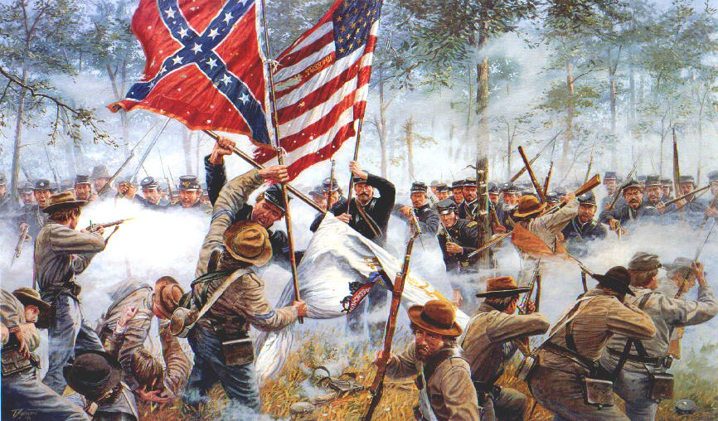
Battle of Gettysburg: the turning point
July 1-3, 1863
Lee realized that the South was in trouble and decided that it was crucial to attack the North on its own territory (Penn)
Lee was defeated and retreated to Virginia
Gettysburg is the largest battle in the history of the Western hemisphere.
Over 100, 000 people died in 3 days →It was the last time the South invaded the North.

Slide 37
Take out the Gettysburg Address worksheet: 1. What language makes this speech effective and memorable? 2. How does this speech still apply to today?
Do Now:

Slide 38
Gettysburg address
Lincoln’s dedication of war cemetery
Said the war was a test of whether or not a democratic nation could survive
“Now, we are engaged in a great civil war, testing whether that nation or any nation so … dedicated, can long endure… that this nation, under G-d, shall have a new birth of freedom- and that government of the people, by the people, for the people, shall not perish from the earth”
March to the sea
Union army marches from Atlanta, Georgia → Savannah and the Carolinas
Led by Sherman
Total war
Destroyed railroads, buildings, farms in his path
Purpose: to show southerners they cannot win the war

Slide 39
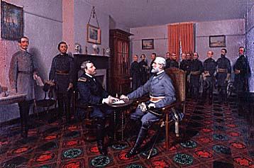
Surrender at Appotmattox
April 3, 1865 - Grant took Richmond Va.
- final blow to Lee's army
Lee surrenders on April 9, 1865 at APPOMATTOX COURTHOUSE
All Confed. troops forced to take an oath of loyalty to U.S.
Lincoln didn't want a humiliated South and further conflict

Slide 40
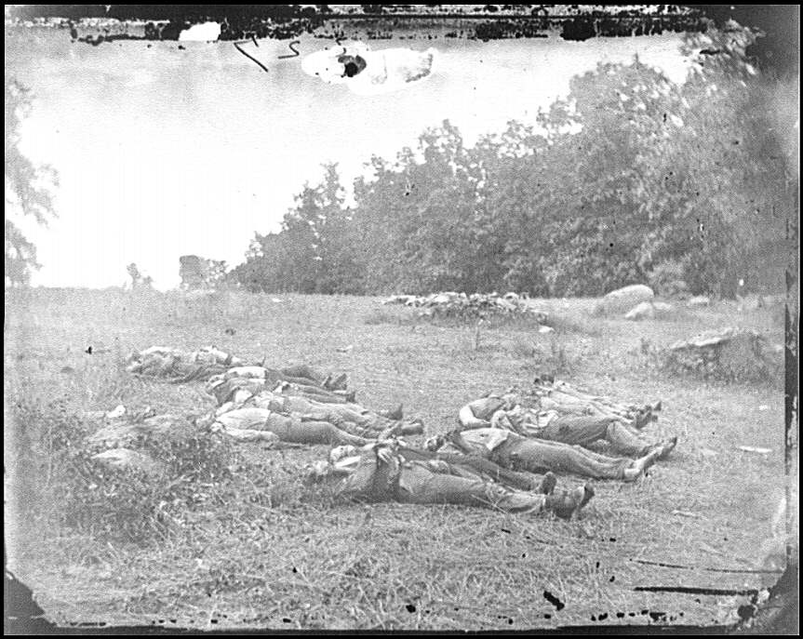
Over 618,000 military deaths during Civil War.

Slide 41
EFFECTS OF THE CIVIL WAR
creation of a single unified country
abolition of slavery
13th Amendment
Freedom for millions of African Americans
increased power to federal government – killed the issue of states rights
Federal government became stronger
U.S. now an industrial nation
Western lands increasingly opened to settlement
South was economically and physically devastated, w/ the plantation system crippled...thus Reconstruction (rebuilding the U.S.) - but a deep hatred/bitterness of the North remained...

Slide 42
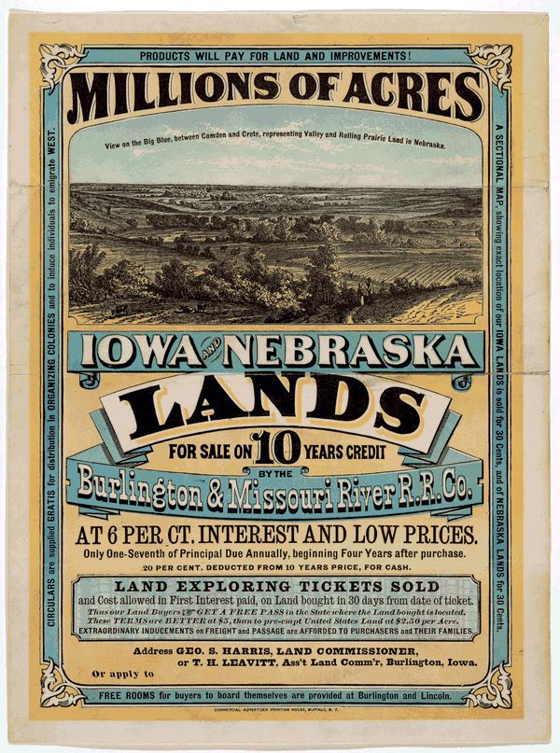
POLITICAL / ECONOMIC DEVELOPMENTS
With out Southerners in the federal gov't, many changes occurred that benefited the North:
1) Homestead Act passed by Congress in 1862 - encouraged Westward expansion w/o slavery
- 165 acres given to anyone who would farm it 5 yrs.
2) Union-Pacific Railway was authorized - great trade potential, focused on the Northern States.
3) Tariffs were put in place to protect Northern industry

Slide 43
…developments
4) Congress established a single federal currency - same value in all states - known as "Greenbacks"
5) to cover war debts, Union gov't issued war bonds and introduced income tax
6) in a further illustration of fed. gov't power, Lincoln's gov't restricted civil liberties so nothing would detract from Union war effort (suspended Habeas Corpus)
- free press/ speech also interrupted
7) 1864 Election - only in Union
- pitted Republican Lincoln against Democrat General McClellan → Lincoln won easily, assuring that war will continue (N. Democrats wanted an end)

