Slide 1
The American Colonies
Ms. Orville

Slide 2
Three Worlds about to meet | Europe | Africa | America
Political System | Middle ages ended (Feudalism) monarchies Feudalism- a political system of power dispersed and balanced between king and nobles. Strong central government replaced feudalism | Ancient kingdoms Wealth through trade and conquest City-states | Iroquois nation- an early form of democracy
Social Organization | Crusades- to spread Christianity carried over into the new world | Tribes | Tribes (location) Religious beliefs
Economic system | Trade within Europe Commerce- Nations became wealthy: could fund explorations | Trade in West Africa: gold & salt Slave trade begins in late 1400s to Europe | Bartering and trade
Main ideas and values | Renaissance- revival of learning & inventions | Culture built on trade and trust | Deep respect for the natural environment

Slide 3
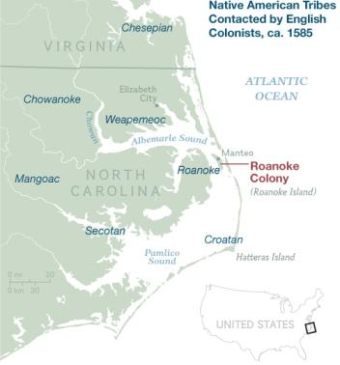
The Roanoke experience
The first group of colonists almost singlehandedly doomed the colony.
1. They arrived too late in the season to plant any crops that would survive the cold winter.
Because of that, they had to rely on the supplies that they had brought with them, which were not designed to last all winter.
2. Under the direction of Ralph Lane, a captain in the armed forces.
His first priority was to build a fort; houses were then built around the fort, some with brick but most of wood.
He saw the neighboring Roanoke tribe as possible enemies; and when a dispute over a cup turned violent, it was Lane who ended up killing Wingina, the Roanoke chief.

Slide 4
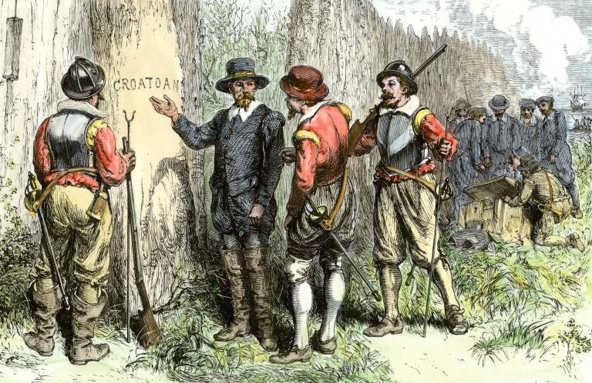

Slide 5
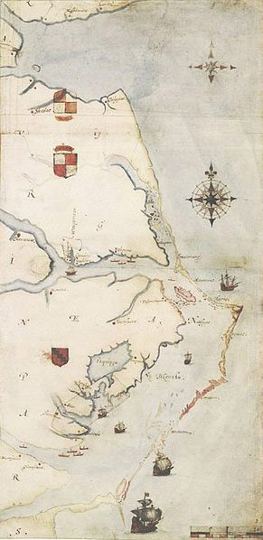
Roanoke Colony [[England]]
The “Lost Colony” & first attempt at colonization
Roanoke Island off the shore of North Carolina.
Intended as a permanent English settlement
Financed and organized by Sir Walter Raleigh under a charter granted by Queen Elizabeth I.
Under this charter, Raleigh had seven years to establish a settlement before losing colonization rights.
Raleigh funded the expedition under the leadership of Ralph Lane and Richard Grenville.

Slide 6
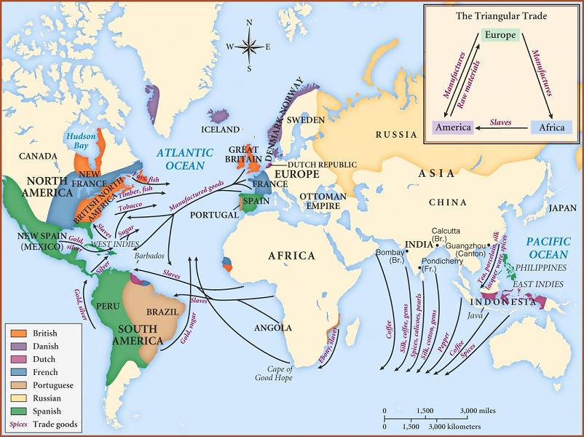
Reasons for colonization
Spain found gold → England wanted to find gold

Slide 7
Aim: Was Roanoke a success or failure?
Failure
Success

Slide 8
Final questions: [[Write on a piece of paper and hand in]]
What do you think happened to the original Roanoke settlers?
Why do we celebrate Thanksgiving?
What have Europeans and Native Americans exchanged?

Slide 9
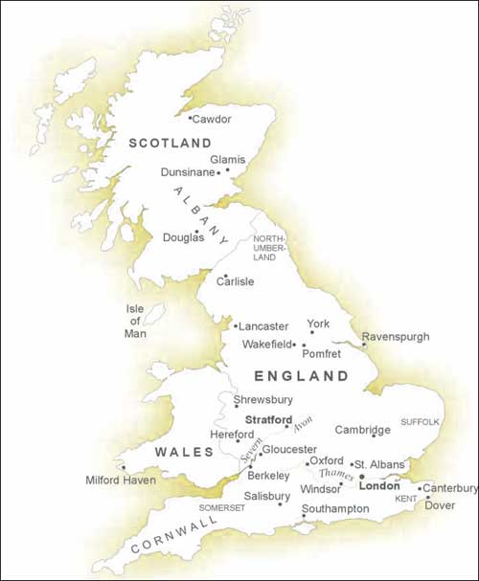
Why did the English colonize America?
Political and Military: the fall of the Spanish Armada
Spanish attempt to invade England stopped
Opened North Atlantic to English expansion
Had the military resources to send to the ‘new world’
Economic: changes in English economy
Rising merchant class- invested in joint stock companies
Overpopulation in British cities
Needed more land and resources

Slide 10
Do Now: Which area of America did England colonize? → Why there?

Slide 11
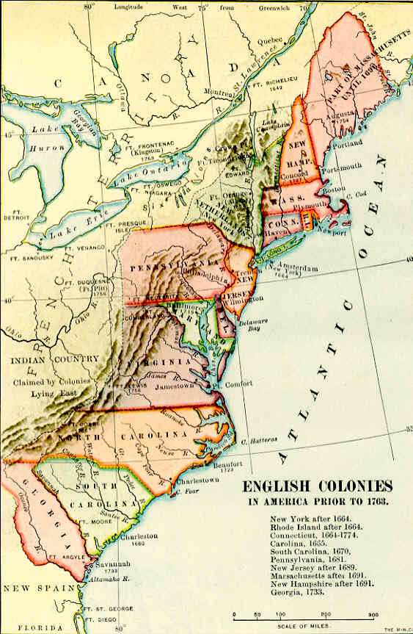
England
England approached America from the east coast.

Slide 12
Jamestown

Slide 13
Jamestown (1st successful English colony)
Virginia Company received charter from King James 1 for settlement in America
Goals
Gold and wealth
Convert Indians to Christianity
Find a passage to the Indies
Great difficulty was experienced adjusting to the new environment
Early groups suffered from laziness, starvation, and malaria
Saved by the leadership of John Smith (in charge of colonial council) & John Rolfe (tobacco)
Crucial assistance was offered by Chief Powhatan and his tribe

Slide 14
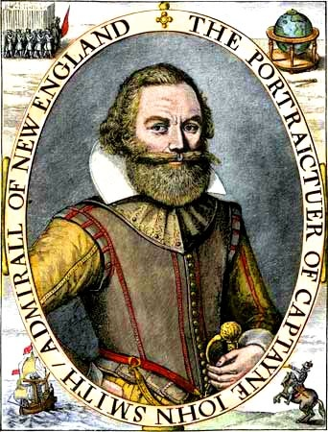
Jamestown
John Smith:
took control of the Jamestown colony
he saved the colony by forcing everyone to work and farm
Powhatan (local Native Americans) helped John Smith and the colonists by providing food and support. John Smith did everything he could to establish good relations with Chief Powhatan.
John Smith got really sick and had to go back to England. After he left the new colonists that came destroyed the relations Smith had developed with the Powhatan.
Brown gold= tobacco

Slide 15
Chief Powhatan

Slide 16
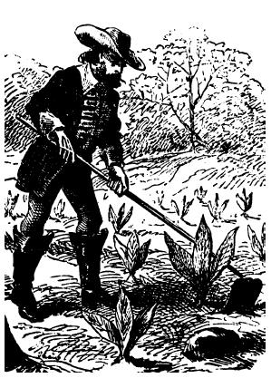
Jamestown
John Rolfe
Perfected methods of raising and curing tobacco
Tobacco
Brought money and workers to Virginia
Problems with tobacco farming
Chained prosperity of Virginia to one crop
Exhausted the soil
Promoted large-acreage plantations which needed large amounts of cheap labor
Antagonized Native Americans by taking more and more land from them and for continually trying to convert them

Slide 17
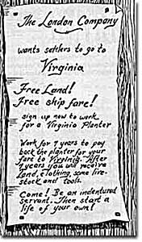
Contributions to Early Virginia
Provided model for further economic investment in America
First representative government: Virginia House of Burgesses [1619]
Negative: demand for slaves
1st slaves sold by Dutch to settlers in 1619
May have been considered indentured servants with legalized slavery later

Slide 18
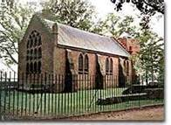
House of Burgesses
A symbol of representative government
22 members
Governor
Appointed by officials of the Virginia Company in London
→ appointed 6 important members of the colony (council)
15 other elected (by the colony) members
George Washington & Thomas Jefferson famous burgesses
Met once a year
Made laws
The first order of business was to set a minimum price for tobacco
Meeting was cut short because of an outbreak of malaria

Slide 19
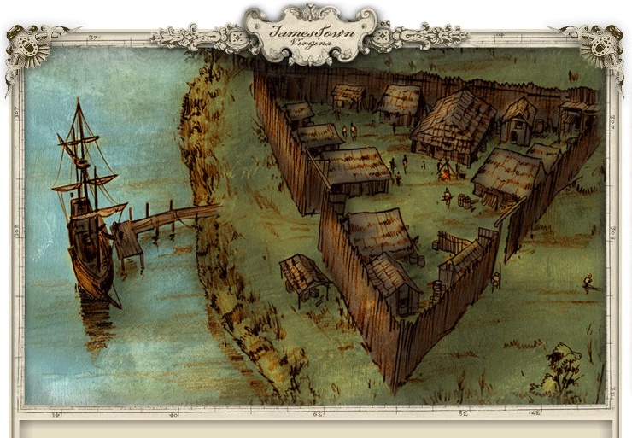

Slide 20
Why did the English colonize America?
Religious- Protestant Reformation
Persecution of Puritans, Catholics, and Quakers led to conflict with religious and political authorities
Flight of Puritans to the New World (they criticized the Anglican Church for retaining too much of the Roman Catholic Church’s ritual and hierarchy)
Anti-Catholic believers (Puritans) felt that the Church of England was not Protestant enough in its beliefs and practices
America was seen as a desirable haven for these groups
Converting natives

Slide 21
Colonial America Vocabulary
Viceroy- official who rules an area in the name of a king or queen
Peninsular- person sent from Spain to rule the Spaniard colonies
Charter- document giving certain rights to a person or company
Joint-stock company- private company that sold shares to investors to finance trading voyages
Capital- money raised for a business venture
Representative government- a system of government in which voters elect representatives to make laws for them
Stockade- a high fence made of wooden posts, built to protect colonists from Indian attacks
Emigrate- leave one’s country to settle elsewhere
Toleration- willingness to let others have their own beliefs
Patron- rich landowner in Dutch colonies
Proprietary colony- English colony in which the king gave land to one or more proprietors in exchange for a yearly payment
Royal colony- English colony directly under the king’s control

Slide 22
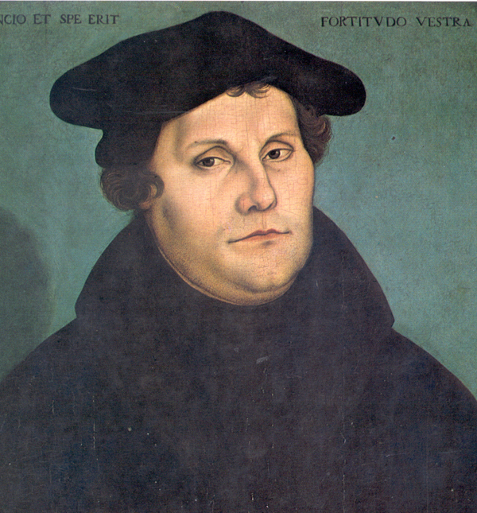
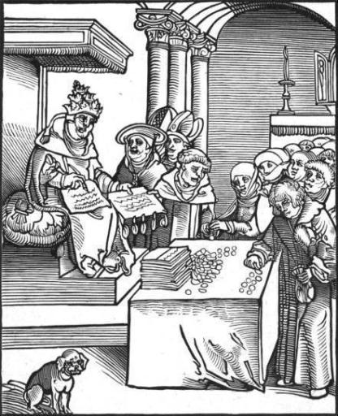
Back in England…
Martin Luther
Disagreed with the church
Founded Protestantism
Corruption
The Church raised money through practices like selling indulgences.

Slide 23
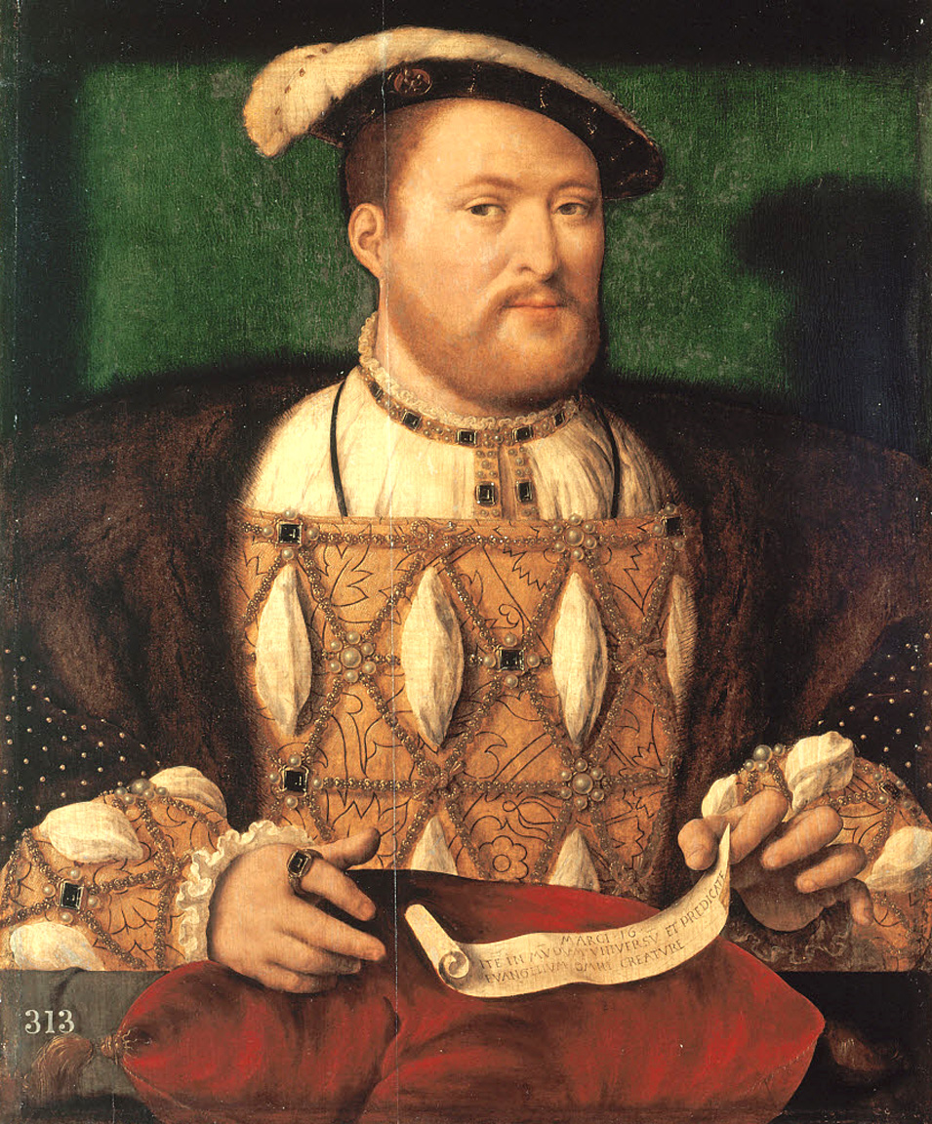
King Henry VIII refused to recognize the Roman Catholic Church and the Pope
Started a new church, the Church of England.
Anglican

Slide 24
Do Now: What is a human life worth?

Slide 25
What is this question really asking?

Slide 26
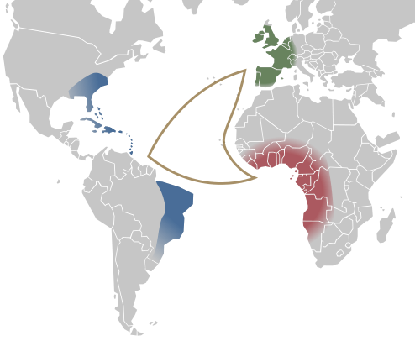
The middle passage…
Journey from Africa in slave ships: the journey from western Africa across the Atlantic to the Caribbean or the Americas, formerly undertaken by many slave ships

Slide 27
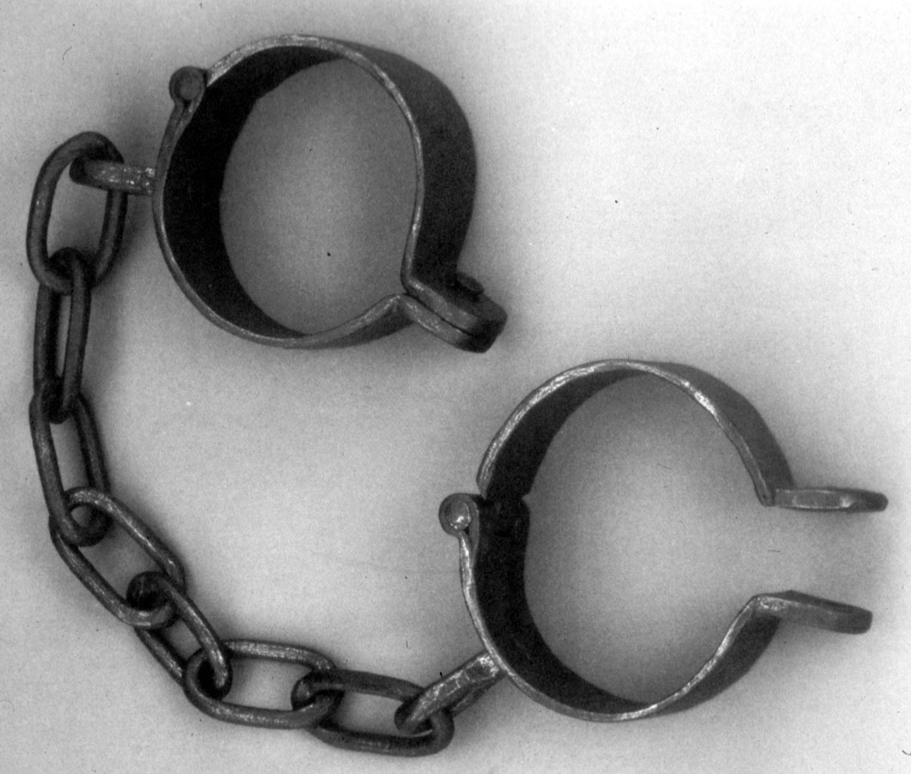
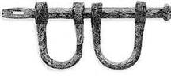
Slavery
Slavery began in the Spanish/Portuguese territories with a high demand for physical labor
Upper-class Europeans didn’t want to do the labor

Slide 28
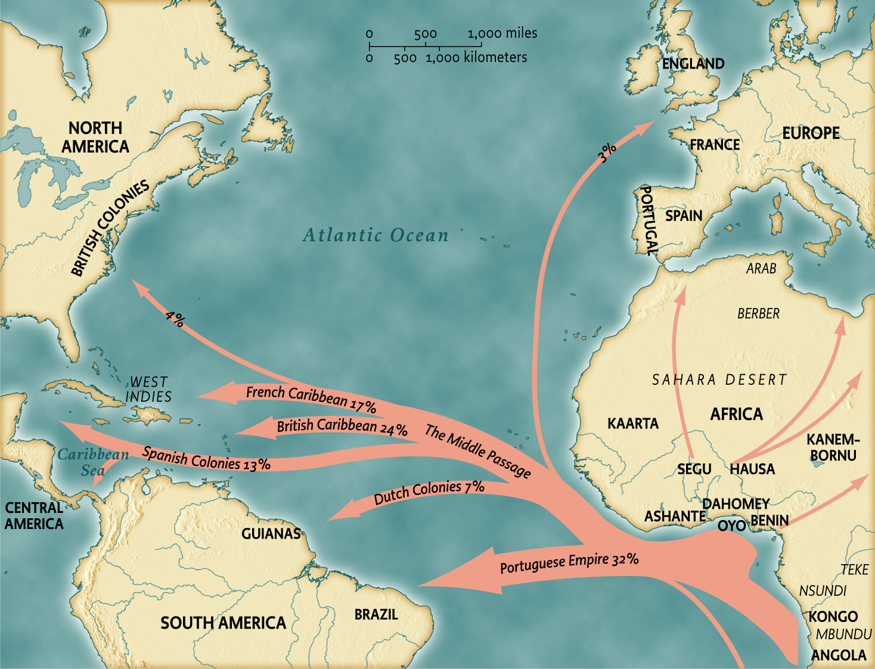

Slide 29
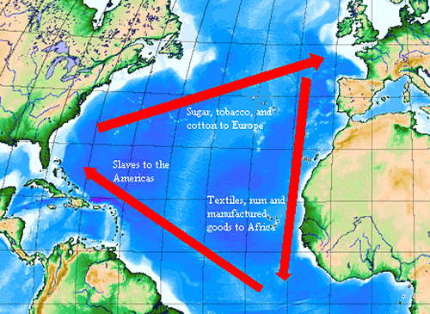
Triangle trade:

Slide 30
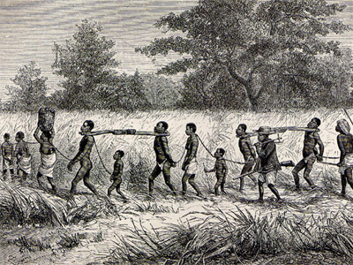
Slave auctions
Taking Africans out of Africa: to be traded and sold as goods
Indentured servant- immigrants in colonial times who voluntarily signed a contract to work for a certain period of years in return for payment of their ship passage to America.

Slide 31
Do Now: What is an example of a democratic document? What makes it democratic?

Slide 32
Do Now: What does this national symbol represent?

Slide 33
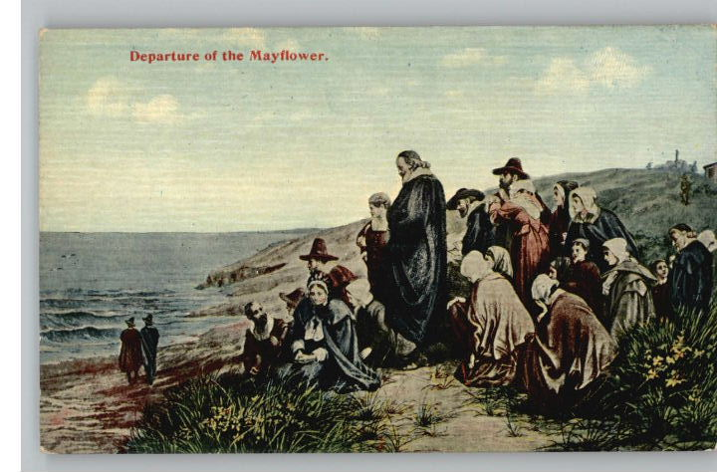

Slide 34
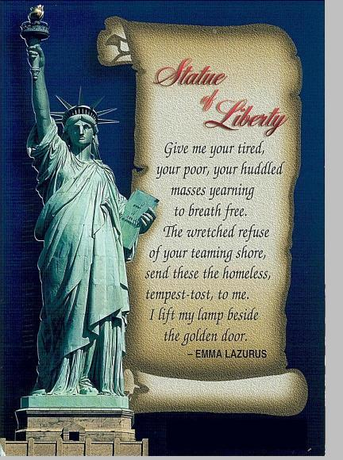
“Give me your tired, your poor, your huddled masses yearning to breathe free…”

Slide 35
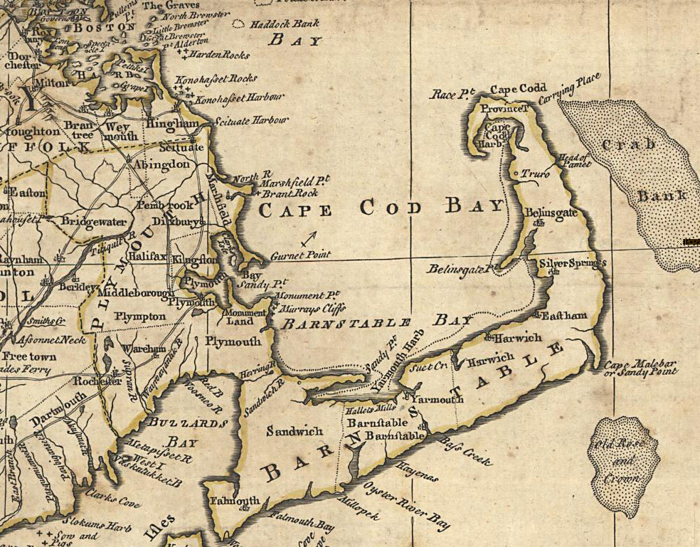
Plymouth Colony
The Pilgrims (Separatists) left Church of England migrated to Holland to seek religious freedom.
They sailed on the Mayflower to America in 1620
Mayflower Compact- first document of self-government in America
Obey laws agreed upon for the good of the colony

Slide 36
MAYFLOWER COMPACT
41 Male passengers on the Mayflower formed into a “civil body politic”, signed a compact promising to write and obey "just and equal laws ... for the general good of the colony."
The compact brought an element of democracy to America and was an example of the practice of self-government in the colonies.
All the colonies practiced some form of self-government…………

Slide 37
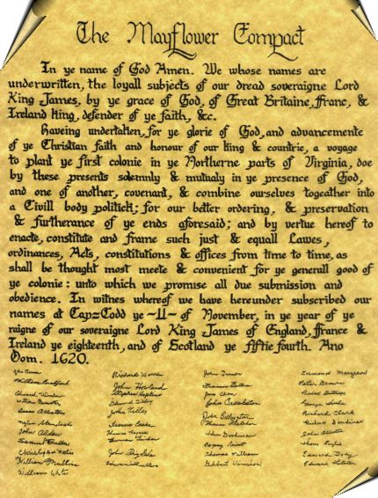
“frame such just and equal laws”, ordinances, acts, constitutions, and offices, from time to time, as shall be thought most meet and convenient for the general good of the colony, unto which “we promise all due submission and obedience”.

Slide 38
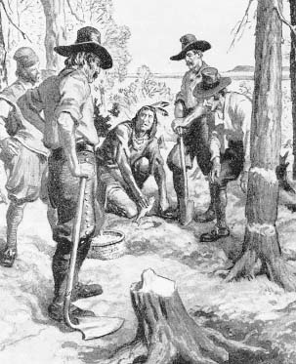
Plymouth
Poorly prepared for the harsh climate:
½ the settlers died in the first winter
Indians befriended the colonists: Squanto acted as advisor and interpreter
Colonists survived under the leadership of Governor William Bradford
wrote the history of the colony
Political decisions made by town meetings and later by elected assemblies

Slide 39
Compare and Contrast Plymouth Colony & Jamestown
Include:
Reasons for coming
Government & leaders
Relations with Native Americans
Problems
Way of life

Slide 40
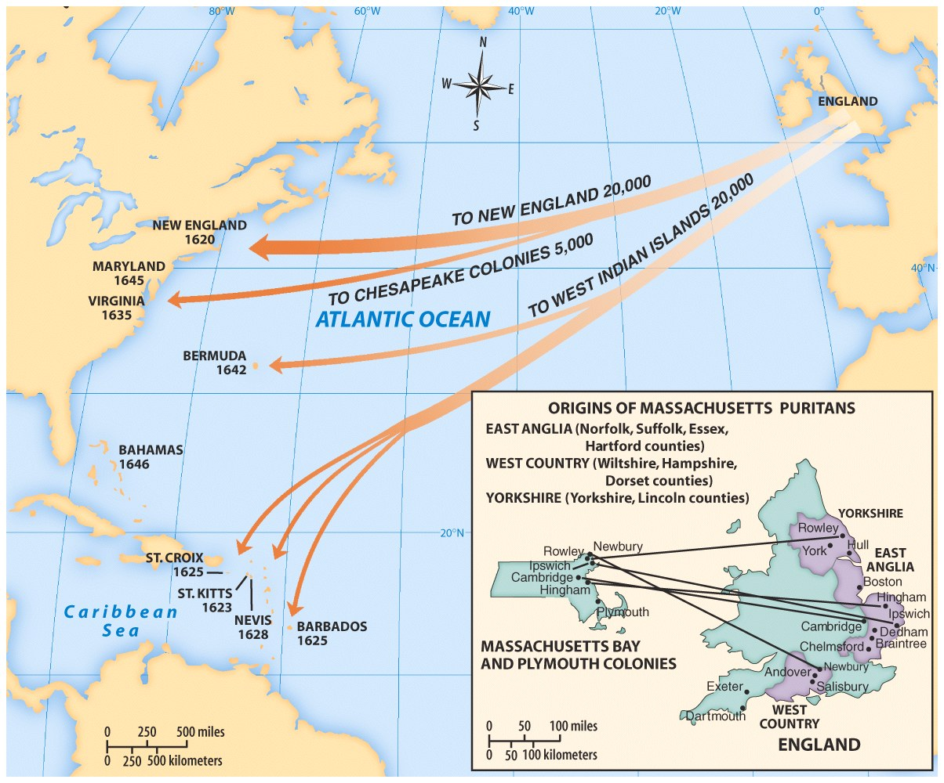

Slide 41
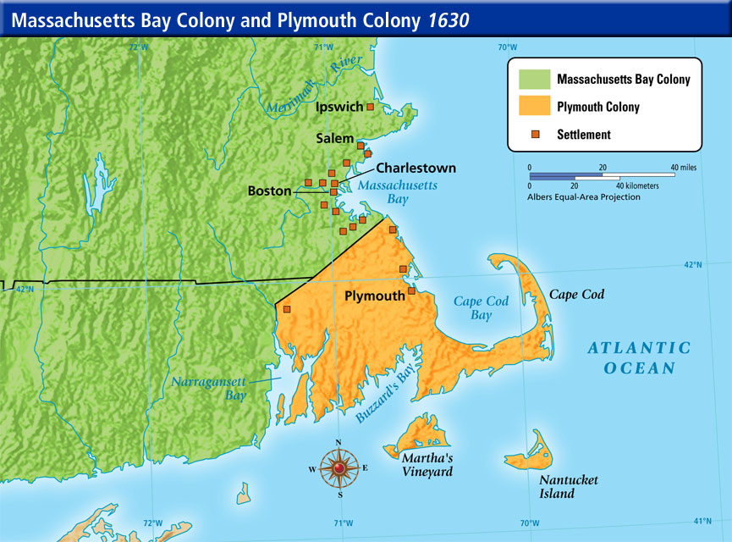

Slide 42
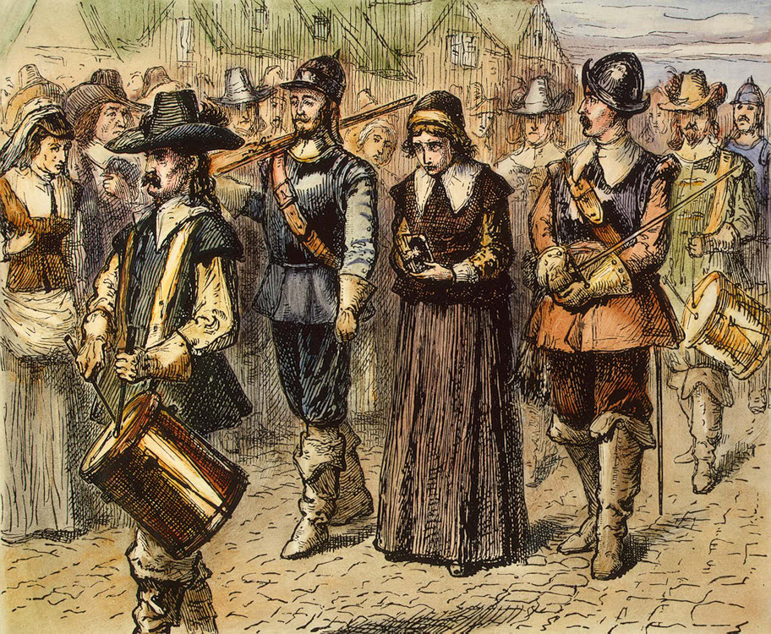
Massachusetts Bay Colony
Anne Hutchinson
Devote Puritan
Expressed her views on religion and criticized minister’s teachings
Said that G-d spoke to her
“deluded by the Devil”
Went to Rhode Island
Founder: John Winthrop
Governor: William Bradford
Puritan Colony
To work hard and create a new holy society
General court:
Elected representatives
All men,
church members

Slide 43
The Puritans
Reasons for migration
Began as a faction within the Church of England: criticized the Anglican Church
Believed religion should be applied to daily life and to the functioning of government
Large numbers of middle class settlers (many educated)
Basic beliefs: “Bible Commonwealth”
Emphasized work ethic
Responsibility for fellow man
Lack of privacy
Intolerance toward dissenters
Piousness
Bible was the literal work of G-d
Wanted a purer form of worship- based on their interpretation of Scripture
Dreamed of owning land
Improving their social positions
Escape:
Bad marriages
Jail terms
poverty

Slide 44
Do Now: What is a witch? How could you identify a witch?

Slide 45
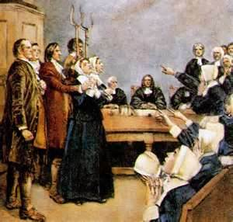

Slide 46
Traits of a witch…
*Singing
*Reading
*Not conforming to Puritan law
*Not getting along with your neighbor
*Spending time alone
*Writing
*Outbursts

Slide 47
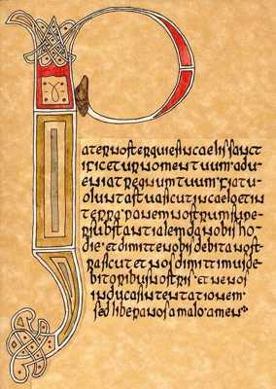
Lord’s Prayer Test

Slide 48
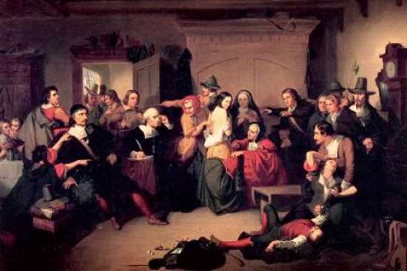
Eye Witnesses Testimonials

Slide 49
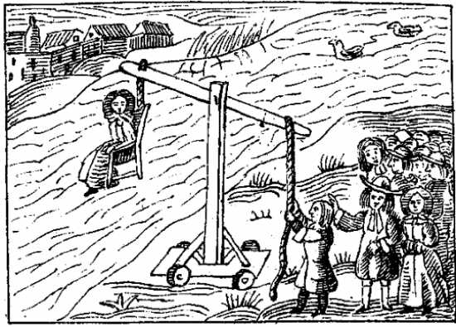
Forced Confession by Dunking

Slide 50
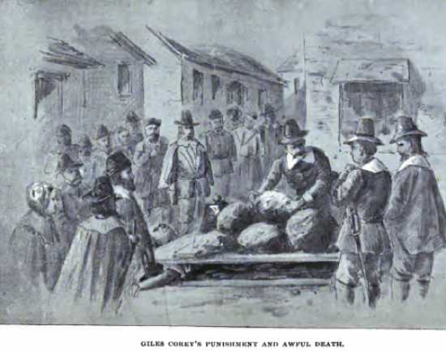
Pressing

Slide 51
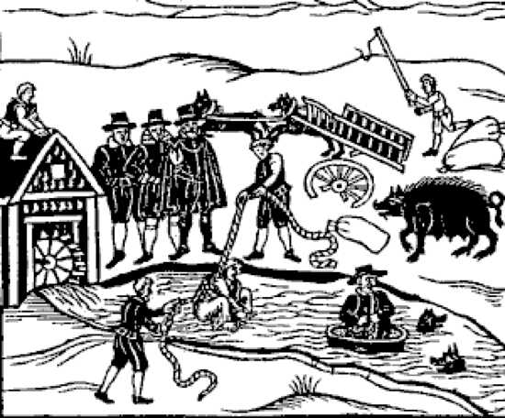
Bound Submersion

Slide 52
Do Now: What is the difference between toleration and freedom?

Slide 53
Roger Williams
Young minister in the village of Salem, Mass
believed:
that the Puritan leaders had too much power
Separation of church and state
Religious toleration- willingness to let others practice their own beliefs
Founded Rhode Island

Slide 54
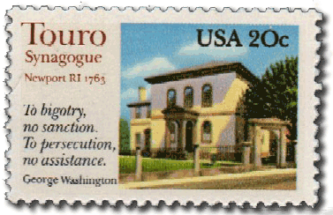
Rhode Island
Founded in 1636 by Roger Williams
Religious freedom
Separated church and state
Accepting of all
Friendly with Native Americas

Slide 55
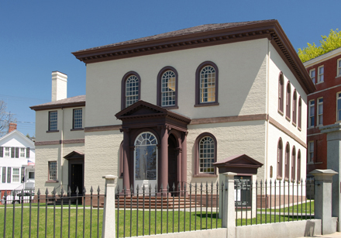
First American Synagogue
Touro Synagogue: founded 1658

Slide 56
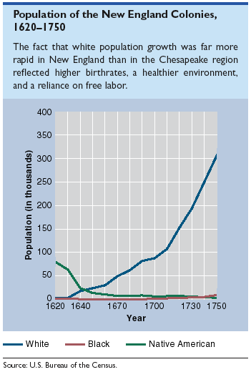
Population of the New England Colonies

Slide 57
Do Now: How did the colonies influence each other?

Slide 58
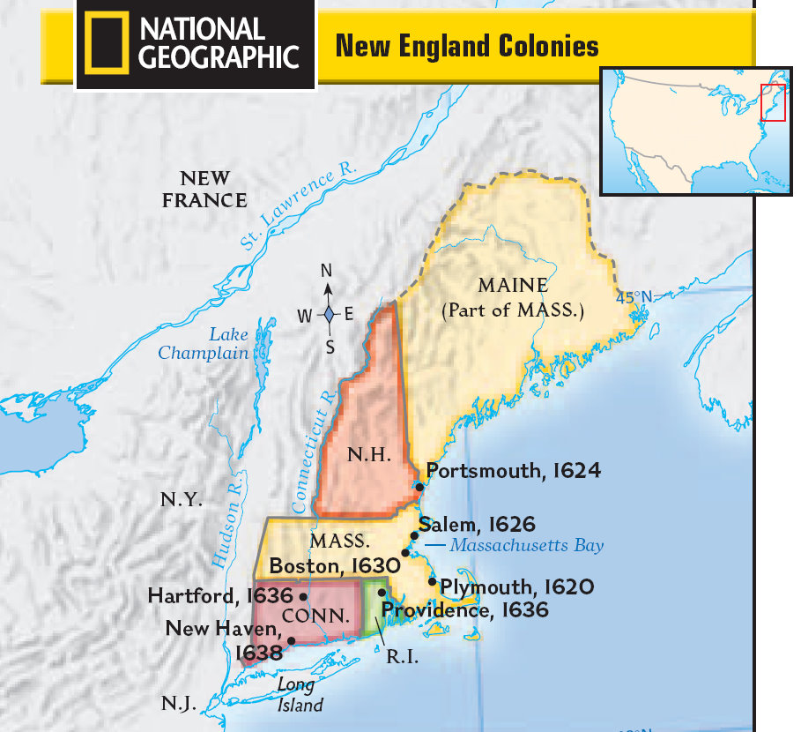

Slide 59
Delaware Connecticut
1638: Swedish settlers
trade
1664: seized by the English
1636: Expansion of trade
Religious & political freedoms
Fundamental Orders of Conn.
"the foundation of authority is laid in the free consent of the people."
Any man owning property could vote
Limited power of governor
New Hampshire
1622
profit from trade and fishing

Slide 61
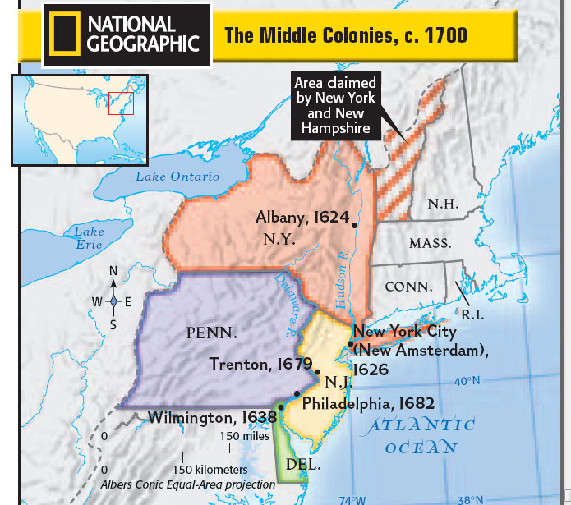

Slide 62
New York New Jersey
“New Amsterdam” 1624
Dutch
Expanded trade
Religious & political freedom
1664: Royal charter from King Charles II to brother: James, Duke of York
English
Freedom of press
1664: Proprietary colony- English colony in which the king gave land to one or more proprietors in exchange for a yearly payment
Trade
Religious & political freedoms
1704: becomes Royal colony

Slide 63
Pennsylvania
Quakers
“Society of Friends”
Holy Experiment
Very peaceful & accepting
Attracts diverse population
Very successful
Rich farmland
Any man who brought his family over received 500 acres of land
1638
William Penn
Proprietary colony
Religious and political freedoms
Profit from land sales

Slide 64
Do Now: Make lists
All the colonies that had religious freedom
All the Puritan colonies
All the proprietary colonies
All colonies with representative/democratic governments
Categorize them in the order they were founded [[YEAR]]
*make sure to identify which group they are from
(New England/Middle/Southern)

Slide 65
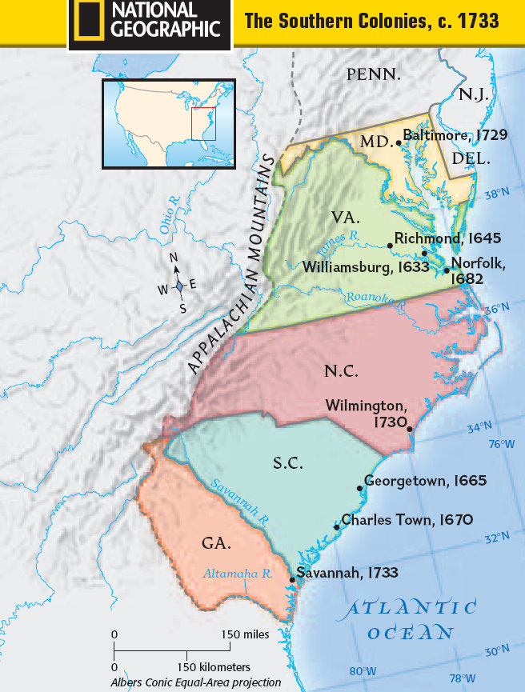
Southern Colonies

Slide 67
The Southern Colonies
Maryland
Georgia
1732
James Oglethorpe
Proprietary colony
Haven for debtors
*buffer against Spanish Florida
Originally southern part of South Carolina
Only small farms & no slavery
Grows slowly
Oglethorpe allows slavery and plantations
1632
Land grant → Lord Baltimore
Profit from land sales
Religious and political freedom
Roman Catholics- elected assembly
Maryland Toleration Act provided religious freedom to all Christians

Slide 68
The Carolinas (1663)
North Carolina 1712
South Carolina 1729
Land grant to 8 proprietors
Trade, farming, religious freedom
Rice & indigo cultivation → leads to need for large number of laborers → African slave movement
Proprietors sold their rights to the king
Became royal colony

